Slide 1
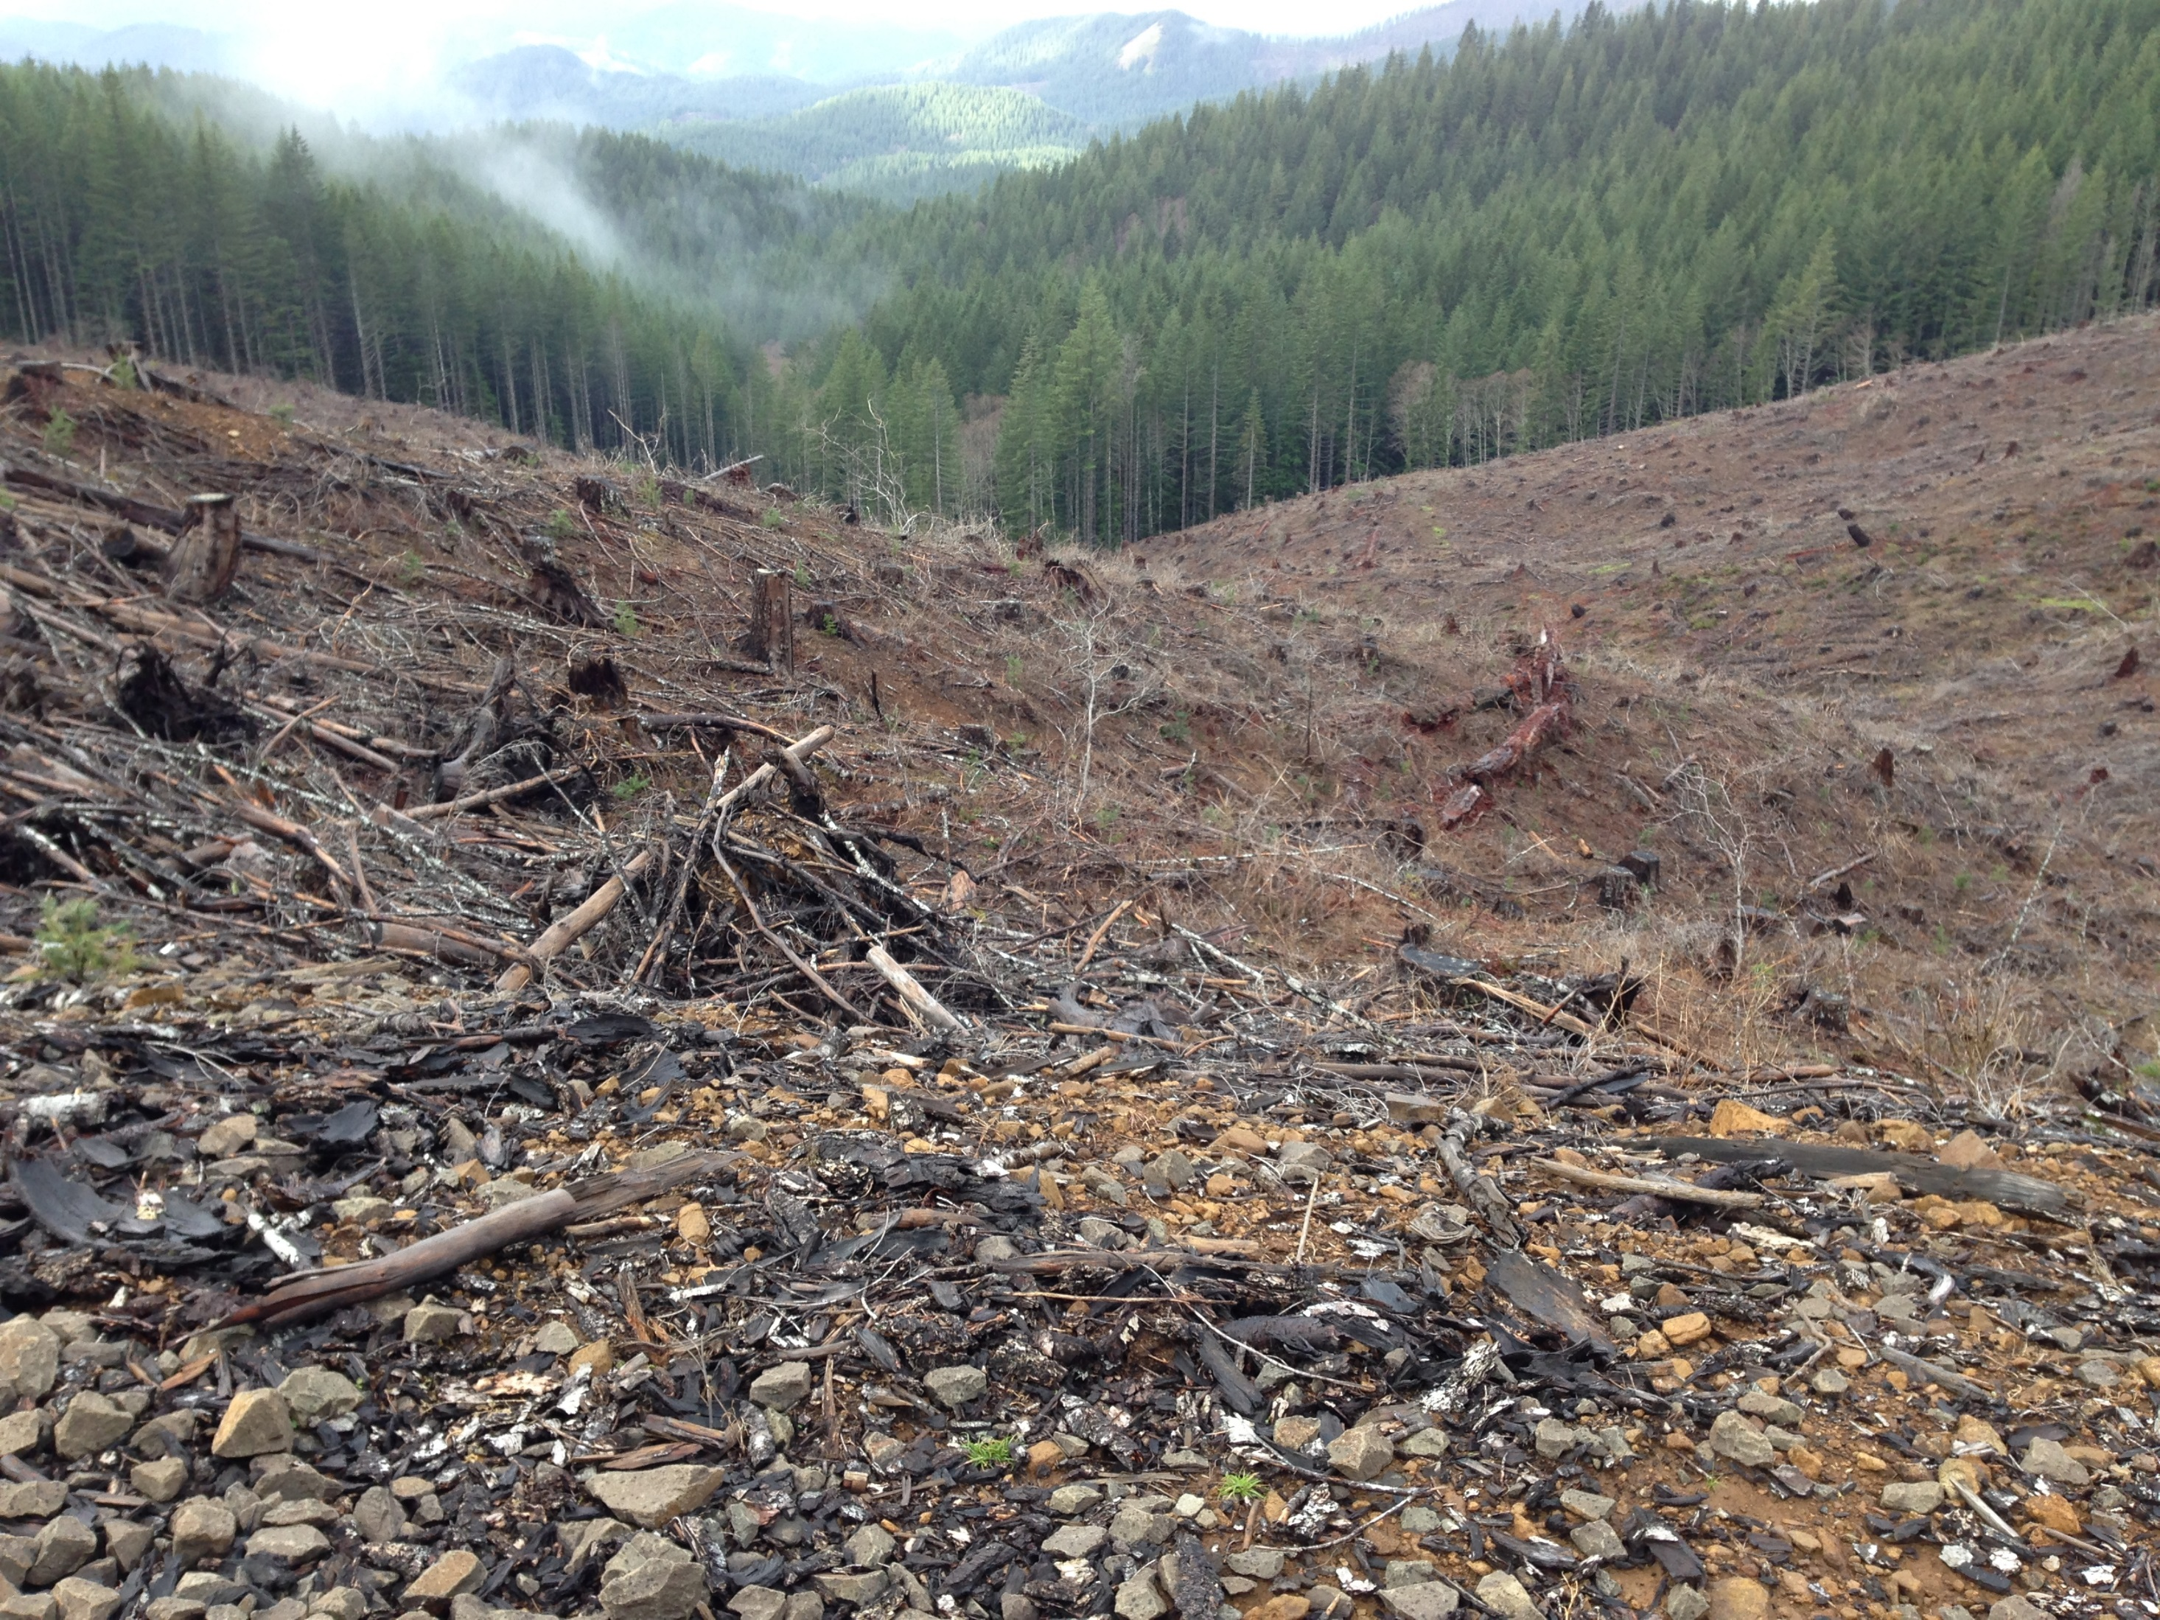
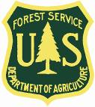
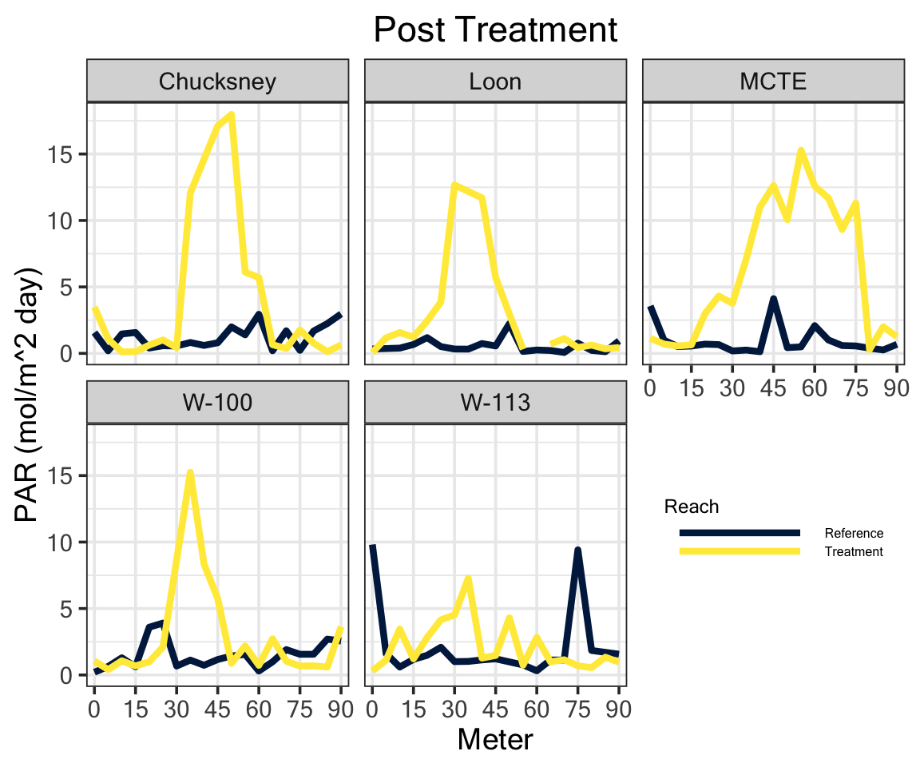
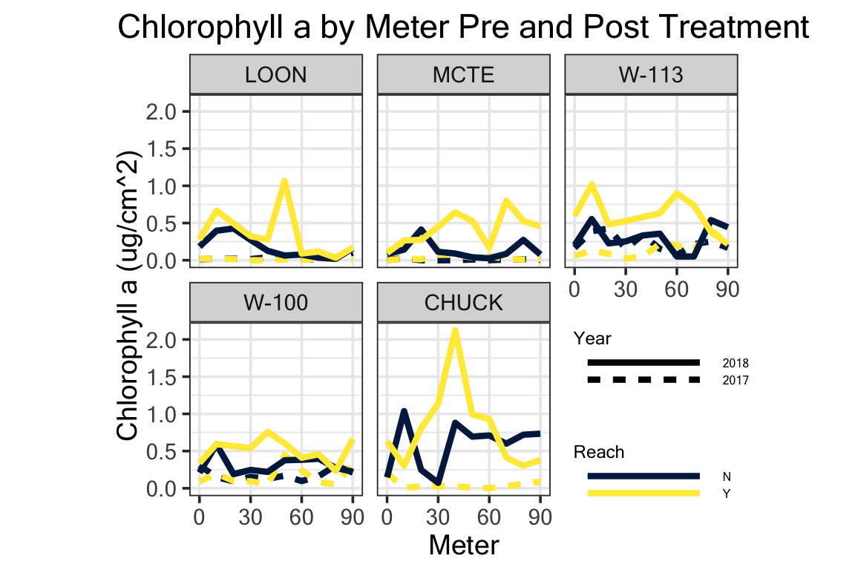
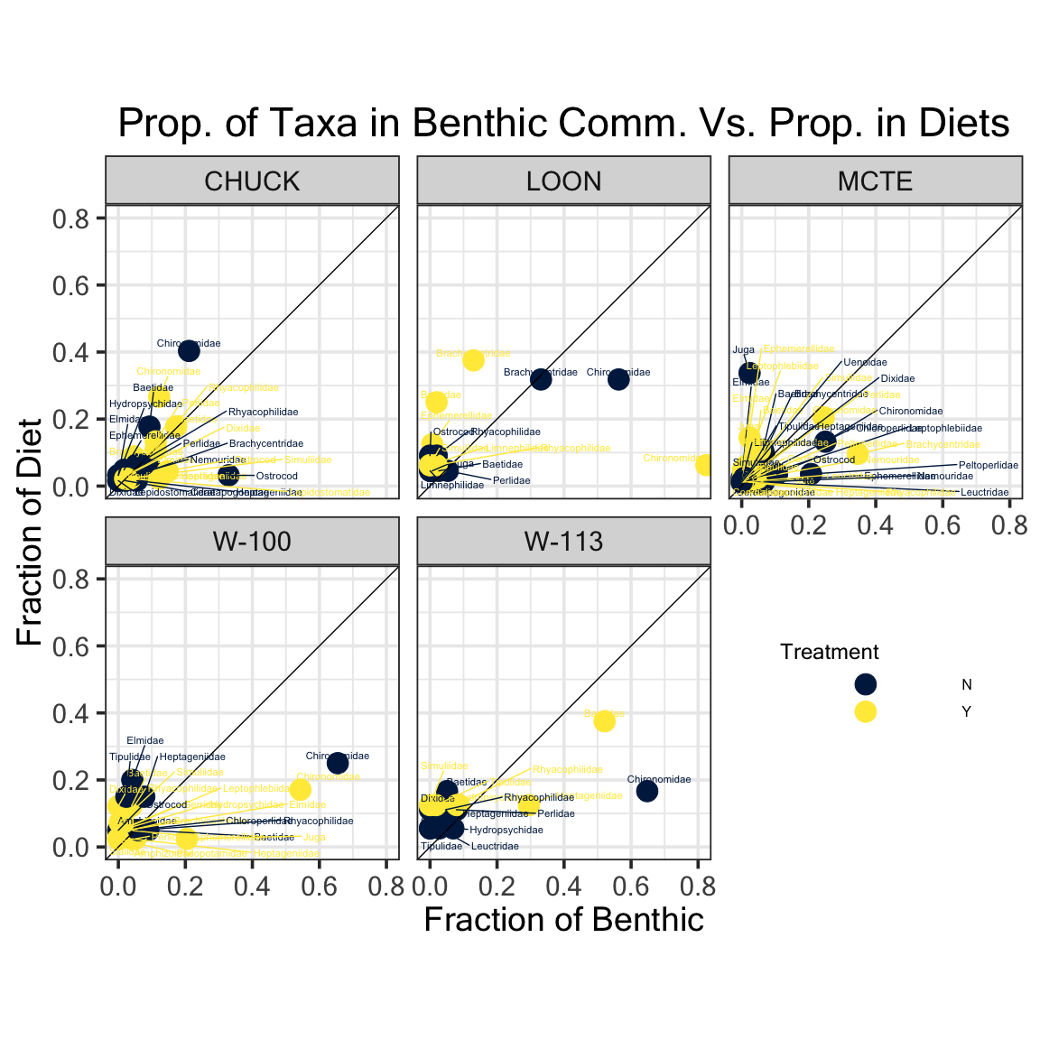
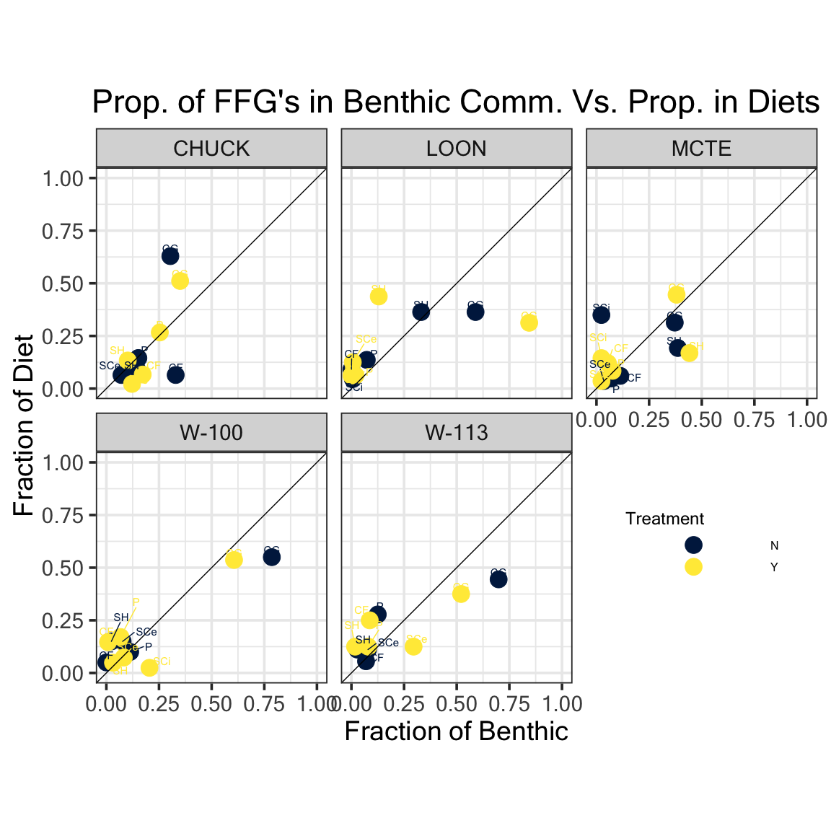
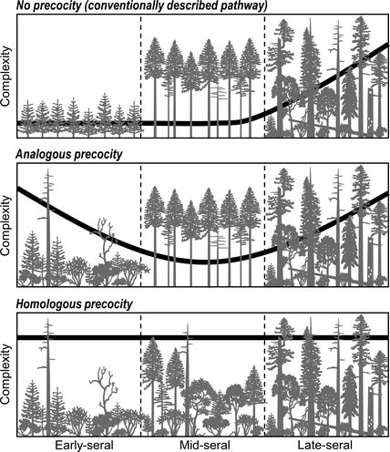
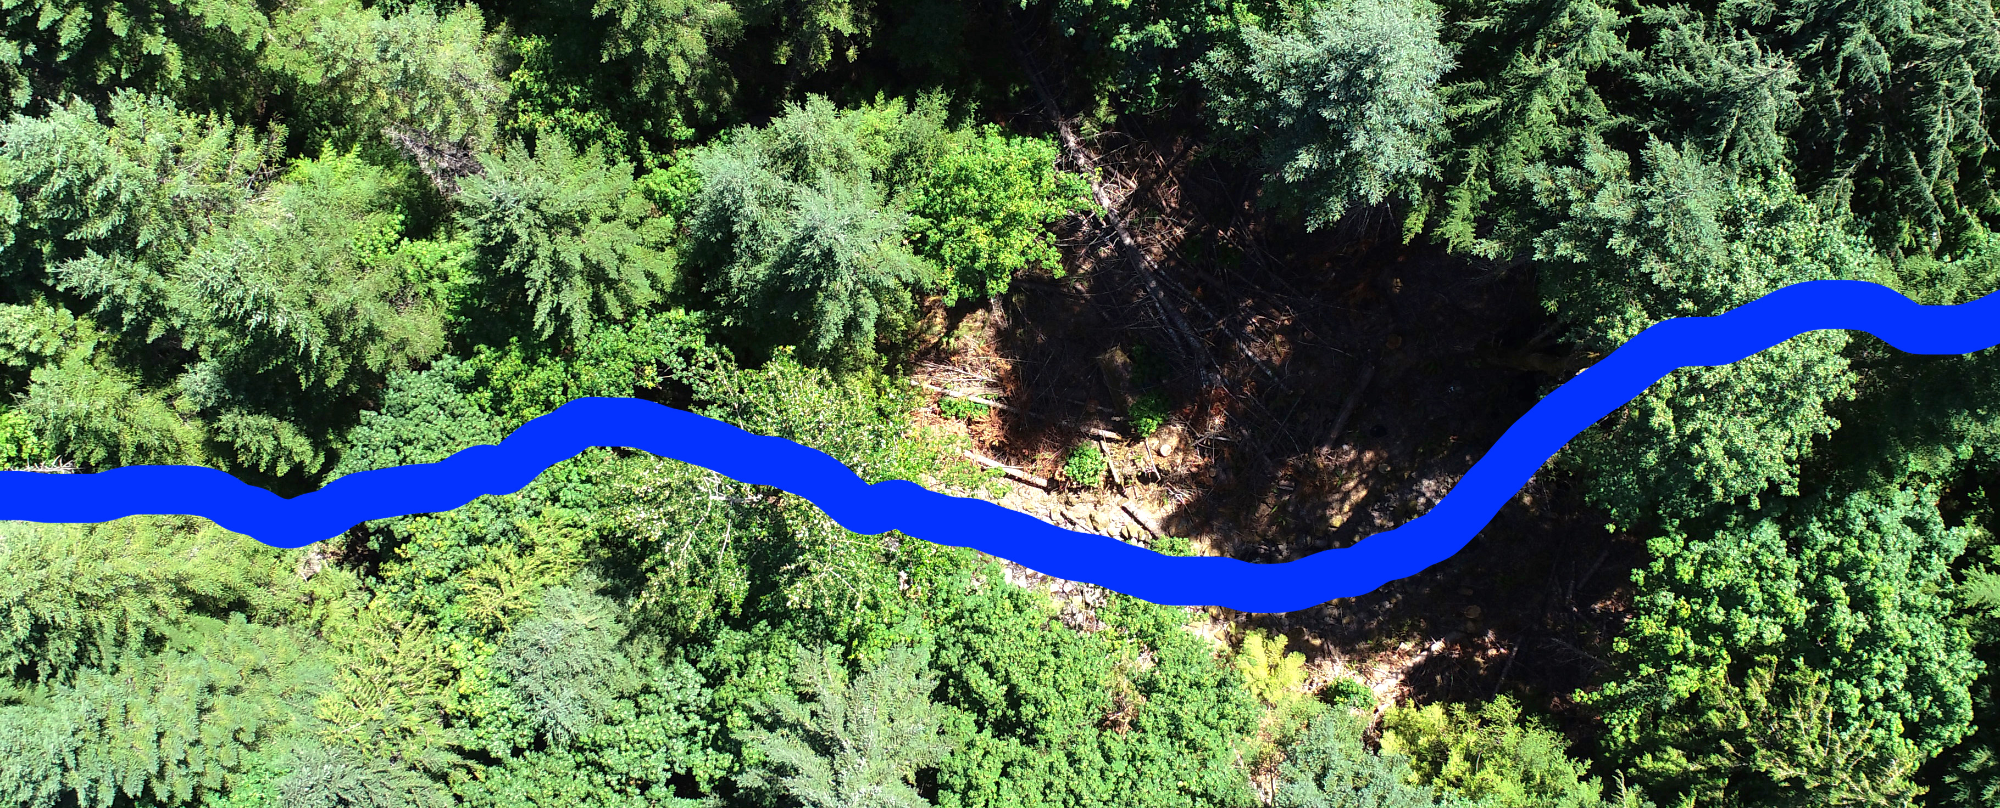
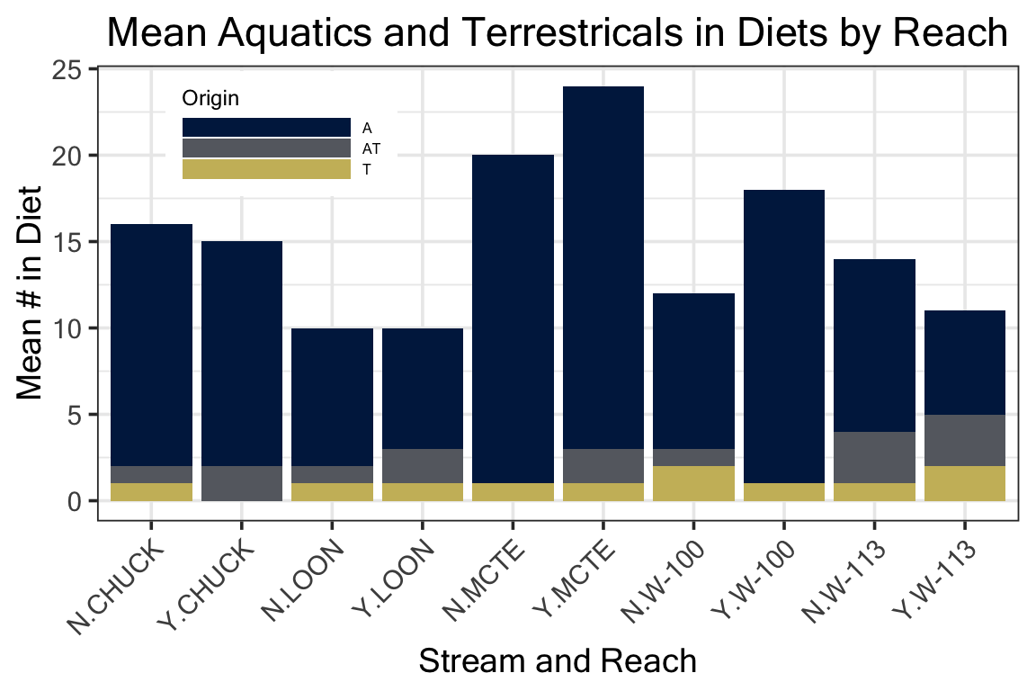
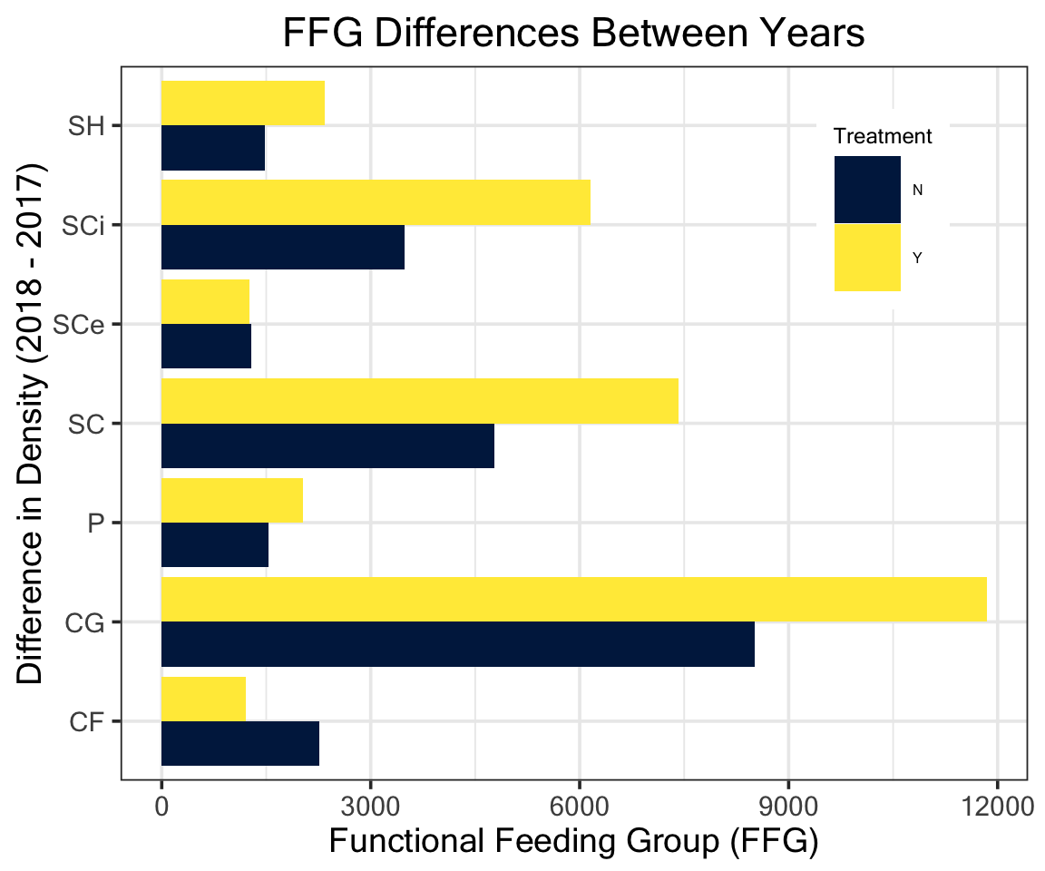
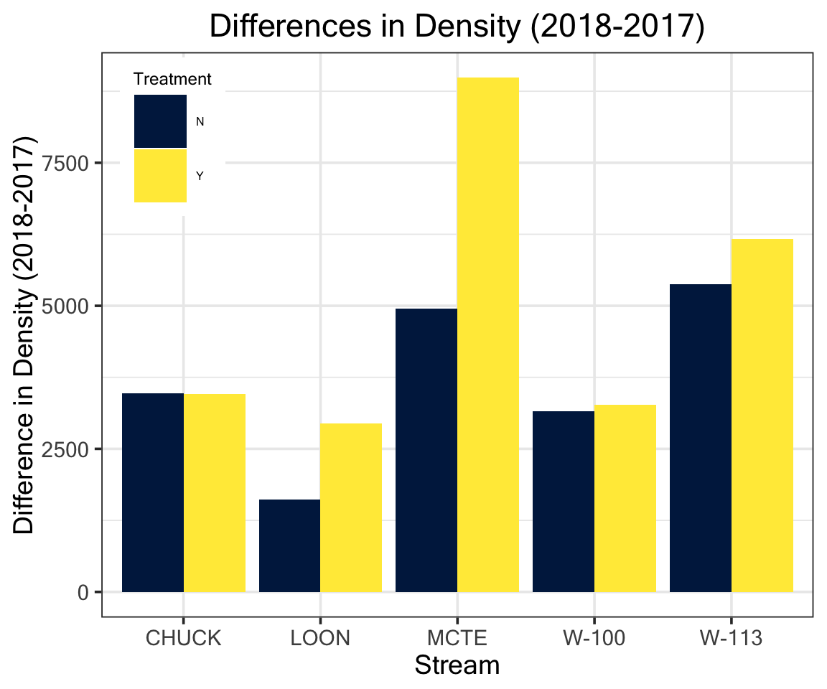
Effects of Light on Fish Diets and Macroinvertebrate
Community Assemblage
Cedar Mackaness^{1*}, Allison Swartz², Dave Roon & Dana R. Warren²
¹College of Earth, Ocean & Atmospheric Sciences - Oregon State University 2, Department of Forests Ecosystems and Society - Oregon State University
*corresponding author: mackanec@oregonstate.edu
Background
Riparian forests in the PNW have been heavily harvested, leaving dense, second growth vegetation that shades out streams. As these forests undergo stand development, tree mortality and natural disturbances will increase canopy heterogeneity and light availability.
Figure 1. Illustration showing second growth forests with closed canopies, and old-growth/mature stands with canopy gaps allowing light to reach the stream benthos.
Under current conditions we would expect: dense canopies → light limited GPP → low abundance of herbivorous invertebrates.
Results – PAR and Chlorophyll
Results – Diets
Figure 3. Post-Treatment PAR as calculated from fluorescein decay rate
Figure 4. Total Chlorophyll in treated (Y) and control (N) reaches for 2017 and 2018. *Note missing 2017 control data at CHUCK.
Figure 9.
Figure 10.
Figure 5. Arial view of the gap at CHUCK
Results – Invertebrates
Study Questions
How do riparian forest canopy gaps affect local stream invertebrate communities?
Are any changes in the invertebrate community manifested in fish diets?
Hypothesis: Canopy gaps increase light availability which increases the abundance of grazing invertebrates, and these changes are reflected in fish diets.
Figure 11.
Conclusions
Light and PP went up in the gaps (expected)
Invertebrates show limited response to the treatment
Most distinguishable response is among Scrapers (Collector-Gatherers too)
Trout diets have a variable response across streams
Methods
BACI study design across 5 reach pairs over 2 years. A canopy gap (~30 m. diameter) was cut in the treatment reach in between sampling years.
Benthic samples were taken with a Surber Sampler and diets were collected via gastrolavage.
Benthic samples were ID’ed to LTU, diets were ID’ed to the family level.
Analyses were performed
in R using the Vegan package
Figure 6. Nonmetric multidimensional scaling (NMS) plot of reaches in species space. Sites are numbered 1-4 where 1 = 2017 Ref, 2 = 2017 Treat, 3 = 2018 Ref, and 4 = 2018 Treat. BenthoTotal is Chla from above.
Acknowledgements:
HJ Andrews Experimental Forest, Greg Downing, Jay Sexton, Mark Schultz, Maryanne Reiter, Alvaro Cortes, Matt Kaylor, Nate Day, Corey Culp , Matt McDonald
Figure 7. Functional Feeding Group sum across streams of differences between years
Figure 8. Differences between years in total invertebrate density.
Figure 2. Study area in western Cascade mountains of Oregon

